Slide 1
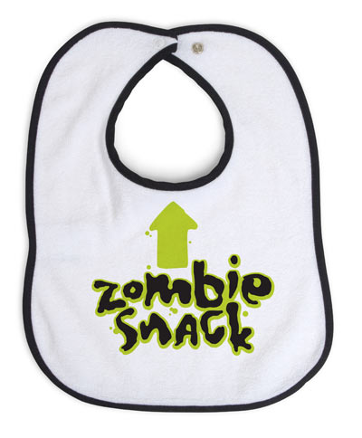
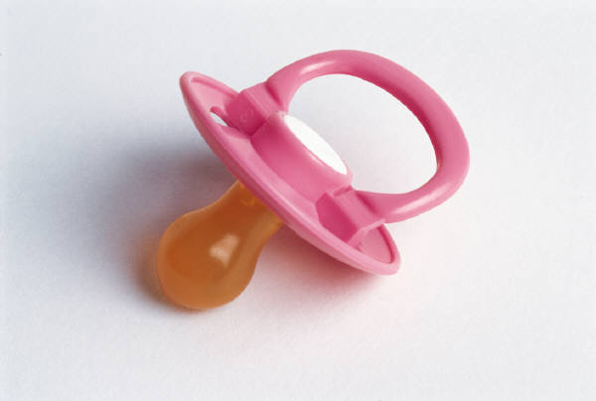
Baby project
Parents:
Justin s.
Alma p.

Slide 2
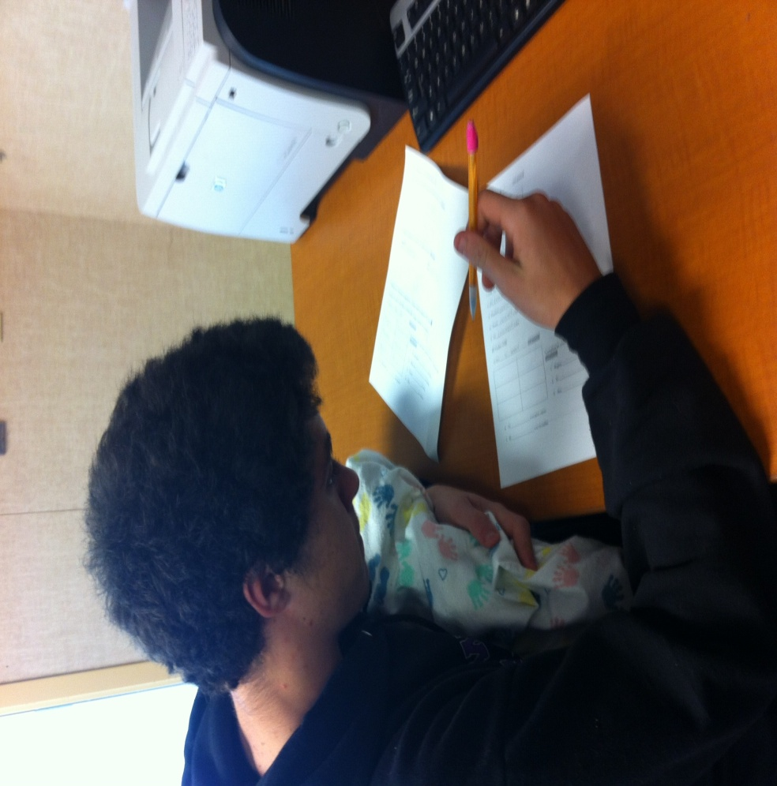
Struggles
The waking up at 12 am-5 am
Keeping the baby safe and bundled
Keeping the schedule up to date
Working in class with the baby
Typing
And getting food

Slide 3
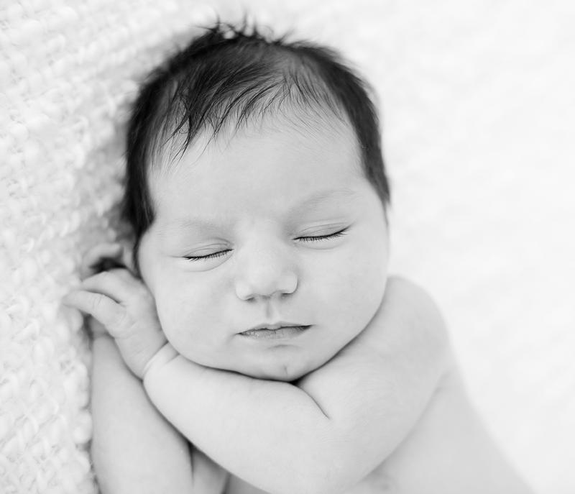
Success
We kept the role up to date
We had fun
our baby is safe
We finished our assignments

Slide 4
What we liked
The baby experience was fun
Keeping care of a doll during school time
Making the baby was fun

Slide 5
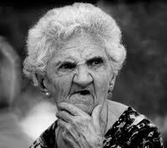
Others people expressions

Slide 6
Our experience
It was weird because of the peoples look and the taking care of a baby during class
It showed the struggles of taking care of a baby
And the urge to rock and comfort a baby

Slide 7
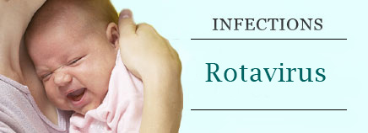
Disease
Our child had the Rota virus
It causes inflammation of a Childs intestines
Causes diarrhea, vomiting, fever, and abdominal pain

Slide 8
How we raised our baby
We switched of day by day just to insure that we aren’t sleep deprived after

Slide 9
Things we needed to learn
We needed to learn thing like
Baby shaking syndrome
And child abuse

Slide 10
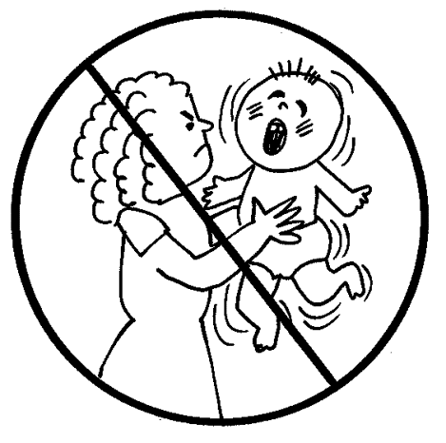
Baby shaking syndrome

Slide 11
Child abuse
Neglect
Physical abuse
Sexual abuse
Emotional abuse

Slide 12
The overall project and the end and thanks for the experience
From what we learned from this project:
Thing that might be sacrificed
Responsibility
What it takes to be a parent

